Slide 1
SWEN ASSIGNMENT 2
Chan zhi mai 1301354e
AARON lim 1300647C
ZHI YONG CHEW 1306307H
NURUL HIDAYAH HAMZAH 1302901B

Slide 2
System Functions – Chan Zhi Mai
Room Reservation – Guest makes hotel room reservation
Reservation List – Receptionist view reservation list of the day
Check-In – Receptionist help guests check-in to hotel room
Check-Out – Receptionist help guests check-Out of hotel room
Billing – Guests pay for Their hotel room

Slide 3
User Characteristics – chan zhi mai
Mr Wang – The owner of the hotel. He is responsible for the day-to-Day management of the hotel and his staff.
Reception Manager – the manager who controls the availability of rooms and the day-to-day functions of the front Office, such as handling guest arrivals or departure. Overall in charge of check-In and check out.

Slide 4
User Characteristics – chan zhi mai
Hotel front desk staff (Receptionist) – responsible to help customer to check-in and check-out of the hotel room.
Guest – provide information for receptionist to key in to the hotel management system when they make room reservation or check-in to hotel room

Slide 5
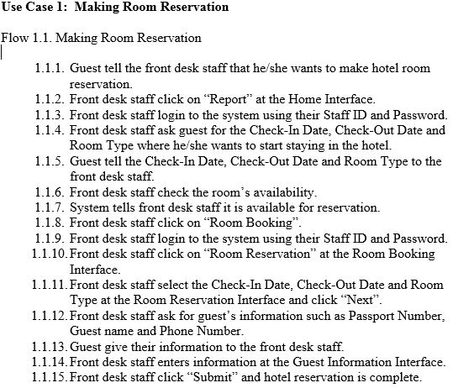
Functional requirements – chan zhi mai

Slide 6
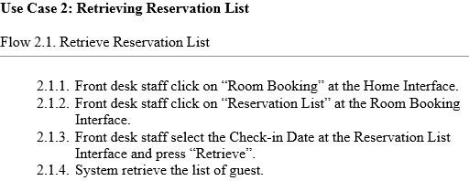
Functional requirements – chan zhi mai

Slide 7
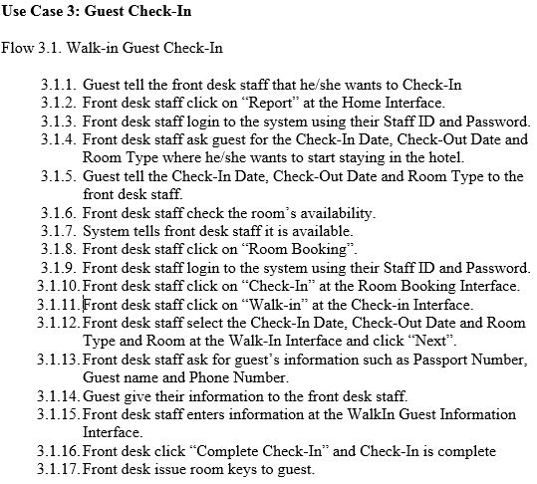
Functional requirements – chan zhi mai

Slide 8
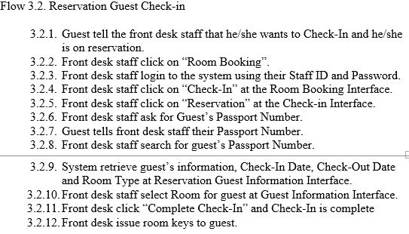
Functional requirements – chan zhi mai

Slide 9
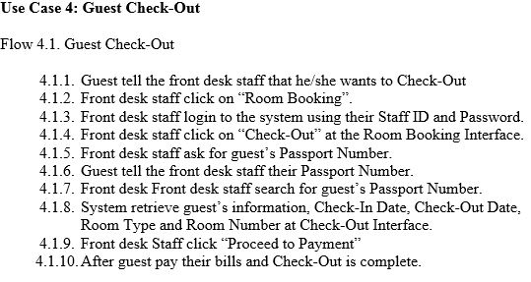
Functional requirements – chan zhi mai

Slide 10
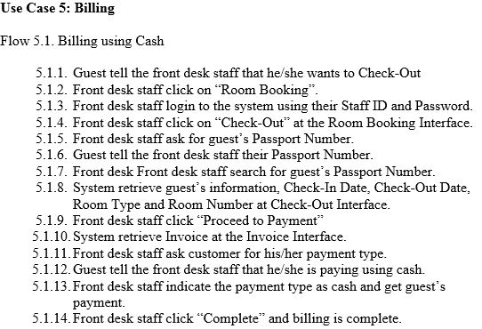
Functional requirements – chan zhi mai

Slide 11
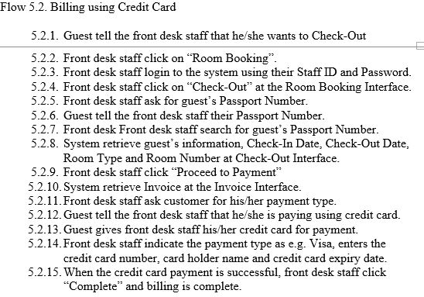
Functional requirements – chan zhi mai

Slide 12
Data requirements – chan zhi mai

Slide 13
Data requirements – chan zhi mai Guests table continued

Slide 14
Data requirements – chan zhi mai guests table continued

Slide 15
Data requirements – chan zhi mai

Slide 16
Data requirements – chan zhi mai

Slide 17
Data requirements – chan zhi mai

Slide 18
Data requirements – chan zhi mai

Slide 19
Data requirements – chan zhi mai

Slide 20
Data requirements – chan zhi mai Staff table continued

Slide 21
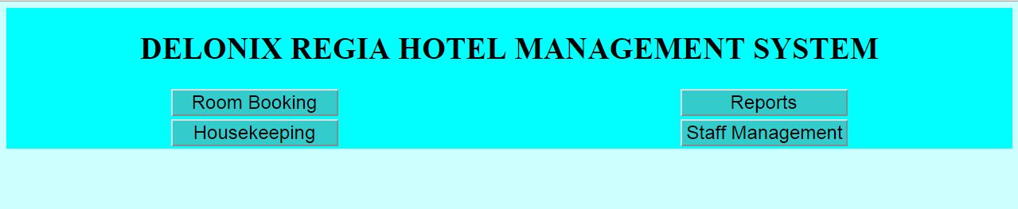
User Interface Requirement – chan zhi mai Home Page

Slide 22
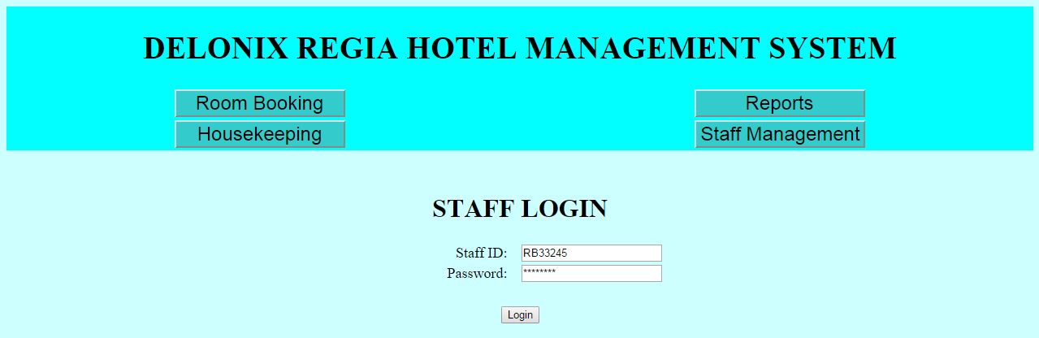
User Interface Requirement – chan zhi mai Staff Login Page

Slide 23
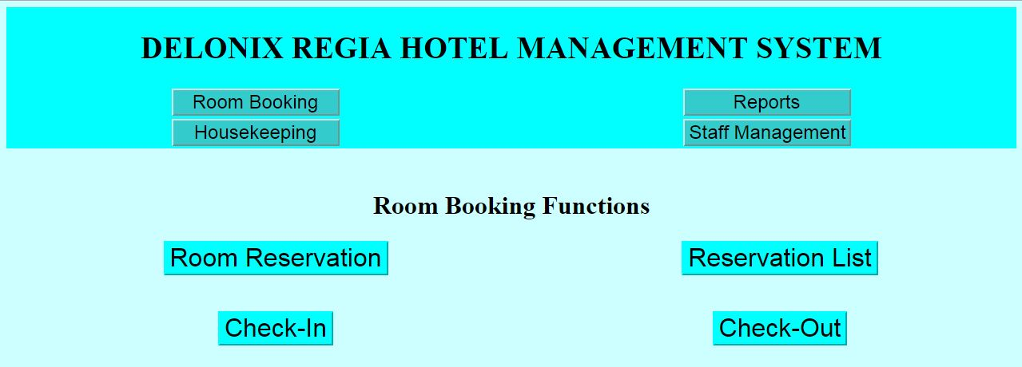
User Interface Requirement – chan zhi mai Room BOOKING Page

Slide 24
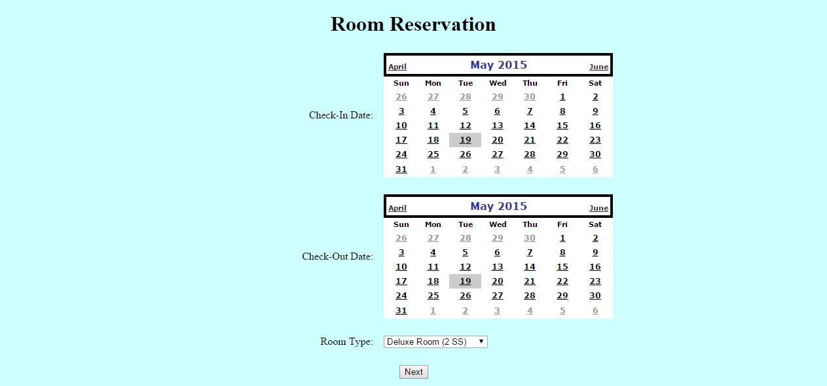
User Interface Requirement – chan zhi mai Room reservation Page

Slide 25
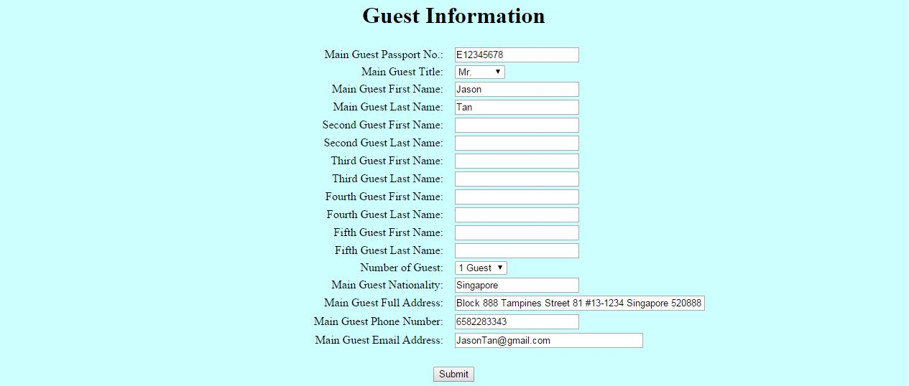
User Interface Requirement – chan zhi mai Guest Information Page

Slide 26

User Interface Requirement – chan zhi mai Reservation list Page

Slide 27

User Interface Requirement – chan zhi mai CHECK-IN Page

Slide 28
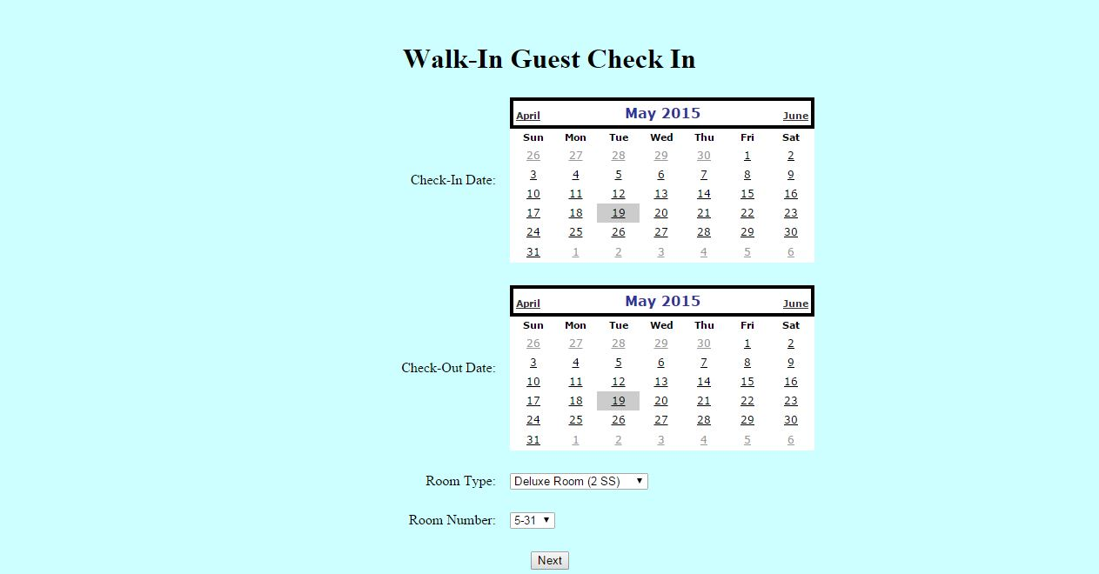
User Interface Requirement – chan zhi mai Walk-IN Page

Slide 29
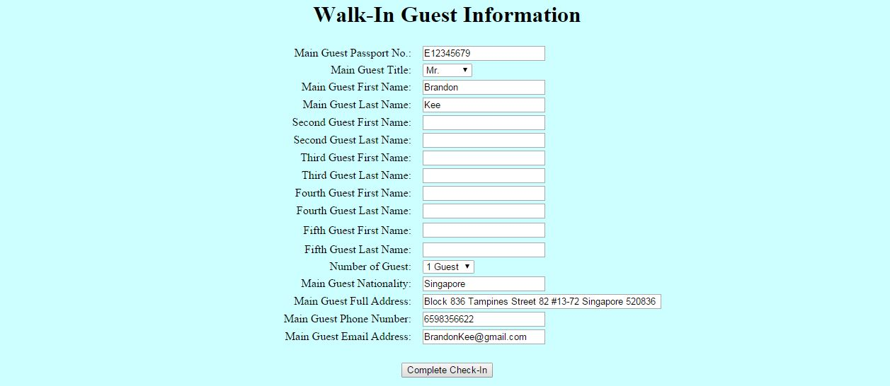
User Interface Requirement – chan zhi mai Walk-IN Guest Information Page

Slide 30
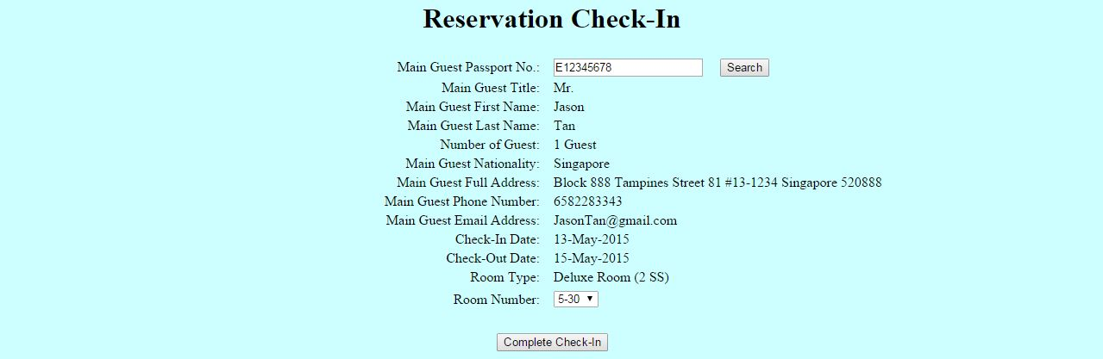
User Interface Requirement – chan zhi mai Reservation Guest Information Page

Slide 31
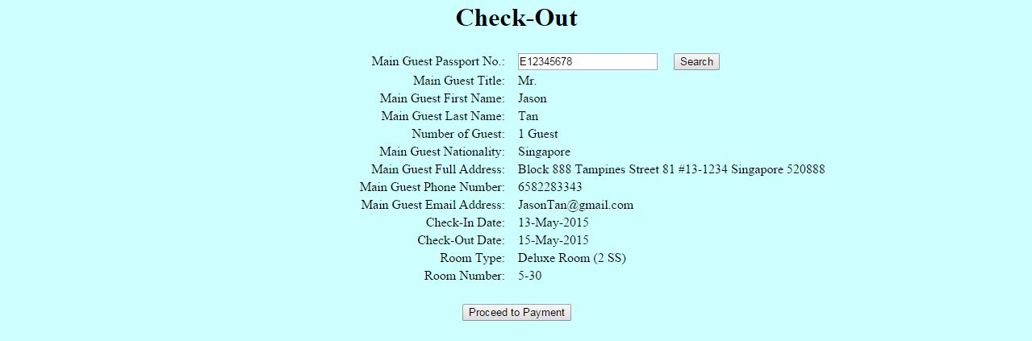
User Interface Requirement – chan zhi mai Check-Out Page

Slide 32

User Interface Requirement – chan zhi mai Invoice Page

Slide 33
Assumptions – Chan Zhi Mai
1. Room only can book/check in to one room at a time.
2. Only 5 guest can live in one room as system can insert five customer per booking.
3. All data shown in the User Interface are sample. It is not the actual data for Delonix Regia Hotel Management System.

Slide 34
Performance – Chan zhi mai
Performance is determine by the acceptable system response time for each function during operation. The performance of the system depends of the hardware and software components of the installing computer. On average, the load time for user interface screens shall not take longer than three seconds due to that there is only 1GB RAM. This makes staff to have fast access to system function. During peak hours, where the computer is constantly being used, the load time of the user interface screens will take longer than average. Four seconds is the acceptable load time of the user interface screen during peak hours. For staff login, the load time of the user interface screen may take up to five to six seconds due to the login information need to be verified with the system database. The above response time are the acceptable on average and during peak hours.

Slide 35
Availability – Chan Zhi Mai
1. Delonix Regia Hotel Management System is required to be available to run 24 by 7 all the time. This is due to guest may come at any timing to book hotel room to stay. Therefore, it is a must to have the system available so that front desk staff can arrange hotel room for the guest.
2. For maintenance and system backup, the only acceptable down time of the system is on the first Sunday of every month from 0200 to 0400 (24-hour clock time) as this timing is likely to have no guest who wants to book h otel room.

Slide 36
Security and access control requirements – chan zhi mai
1. Only Mr Wang and all staff, e.g. receptionist, can access to room booking functions. They will need to log in to their accounts using Staff ID and Password to be able to access the Room Booking functions.
2. For room occupancy report and housekeeping report, only manager and admin which is the owner of the hotel can access to it. Regular staff cannot access to the report.

Slide 37
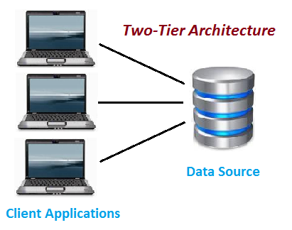
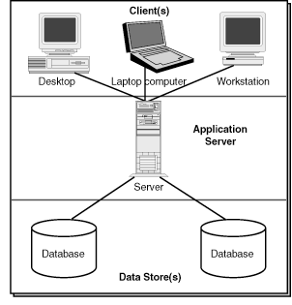
ARCHITECTURE DESIGN – chan zhi mai

Slide 38
ARCHITECTURE DESIGN – chan zhi mai
A two-tier architecture is a software architecture in which a presentation layer or interface runs on a client, and a data layer or data structure gets stored on a server. Separating these two components into different locations represents a two-tier architecture.
Comprises of Client and application

Slide 39
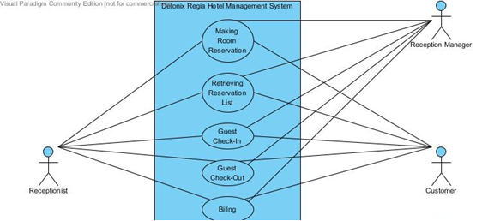
Use Case Model – Chan zhi mai

Slide 40
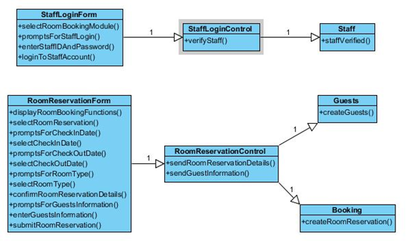
VIEW OF PARTICIPATING CLASS (vopc) diagram – chan zhi mai
VOPC Diagram for Use Case: Making Room Reservation

Slide 41
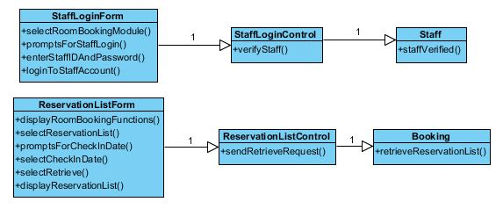
VIEW OF PARTICIPATING CLASS (vopc) diagram – chan zhi mai
VOPC Diagram for Use Case: Retrieving Reservation List

Slide 42
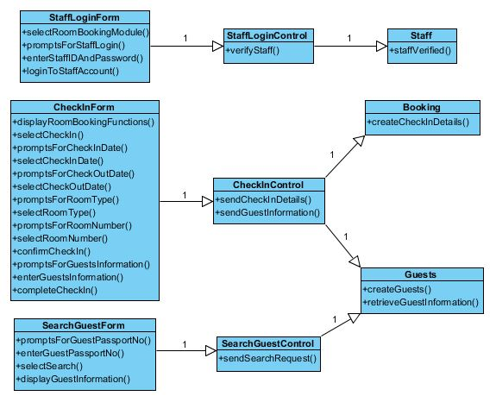
VIEW OF PARTICIPATING CLASS (vopc) diagram – chan zhi mai
VOPC Diagram for Use Case: Guest Check-In

Slide 43
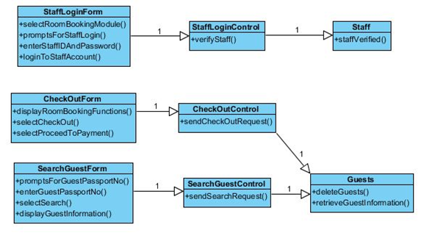
VIEW OF PARTICIPATING CLASS (vopc) diagram – chan zhi mai
VOPC Diagram for Use Case: Guest Check-Out

Slide 44
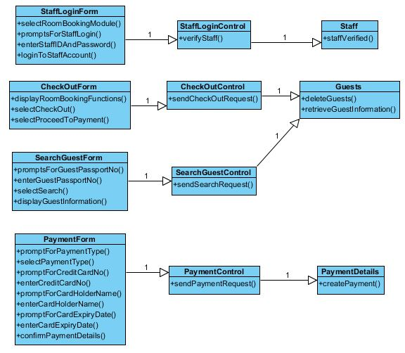
VIEW OF PARTICIPATING CLASS (vopc) diagram – chan zhi mai
VOPC Diagram for Use Case: Billing

Slide 45
Database Schema – CHAN ZHI MAI
PAYMENTDETAILS (MGPassportNo, InvoiceID, CardHolderName, CreditCardNo, CardExpiryDate, PaymentType)
INVOICE (InvoiceID, MGTitle, MGFirstName, MGLastName, CheckInDate, CheckOutDate, RoomID, RoomRates, ConsumedItemsCost, NoOfDays, TotalBill, PaymentType, CreditCardNo, CardHolderName, CardExpiryDate)

Slide 46
Database Schema – CHAN ZHI MAI
GUESTS (MGPassportNo, MGTitle, MGFirstName, MGLastName, 2GFirstName, 2GLastName, 3GFirstName, 3GLastName, 4GFirstName, 4GLastName, 5GFirstName, 5GLastName, NoOfGuest, MG_Nationality, MGFullAddress, MGPhoneNumber, MGEmailAddress)
BOOKING (BookingID, MGPassportNo, RoomID, StaffID, RoomType, CheckInDate, CheckInTime, CheckOutDate, CheckOutTime, Remarks)

Slide 47
Database Schema – CHAN ZHI MAI
ROOM (RoomID, RoomType, RoomLevel, NumberOfBed, BedSize, RoomRates, NoCanDrinks, NoPotatoesChips, Occupied)
STAFF (StaffID, StaffFirstName, StaffLastName, JobTitle, Title, Nationality, FullAddress, PhoneNumber, EmailAddress, Department, DateJoined, BankAccountNo, DOB)

Slide 48
Database dictionary – chan zhi mai

Slide 49
Database dictionary – chan zhi mai Guests table continued

Slide 50
Database dictionary – chan zhi mai

Slide 51
Database dictionary – chan zhi mai

Slide 52
Database dictionary – chan zhi mai

Slide 53
Database dictionary – chan zhi mai

Slide 54
Database dictionary – chan zhi mai

Slide 55
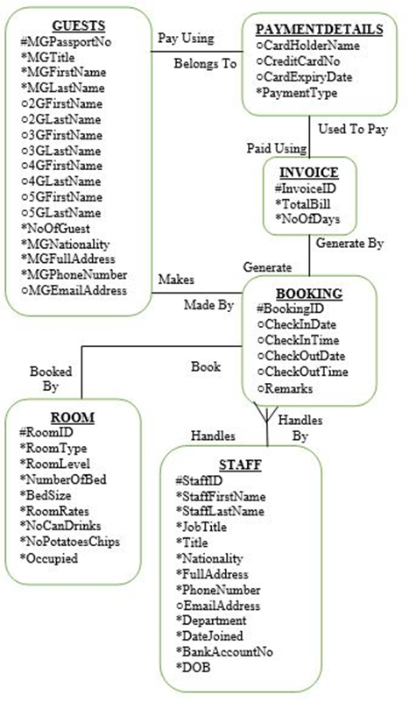
ENTITY RELATIONSHIP DIAGRAM – CHAN ZHI MAI

Slide 56
System Functions – ZHI yong
Allocation of cleaner
Allocation of inspector
Management of room attendant schedule
Management of room mini bar, toiletries
Management of room inspection
Remark of services

Slide 57
User Characteristics – ZHI yong
Housekeeping Supervisor – To allocate duties for the room attendants. Has the ability to add, edit, update and delete of information.
Housekeeping Manager – Has what the functions the supervisor has. Manager has the says to make any amendments to the schedule.
Room Attendant – To view their job duties scheduled to them. Has the ability to change the room status to “Inspection” after completing cleaning the room.

Slide 58
Functional Requirements – ZHI yong
Use Case 1: Room Attendants Availability
Flow 1.1. Checking of how many room attendants are available by supervisor
1.1.1. Supervisor click on the “Housekeeping” button at the home page to login to the system.
1.1.2. Supervisor will enter the user ID and password to login to the system.
1.1.3. Supervisor click on the “Room Attendant Availability” after being login to the system.
1.1.4. System populate the number of room attendant available for the day.
1.1.5. Supervisor will then allocate the tasks as following by the list of room attendant available.

Slide 59
Functional Requirements – ZHI yong
Use Case 2: Tasks Allocation
Flow 2.1. Supervisor Assigning Tasks to Room Attendants
Supervisor click on the “Housekeeping” button at the home page to login to the system.
Supervisor will enter the user ID and password to login to the system
Supervisor click on the “Assign Task” at the home page of the hotel management system.
Supervisor select the room attendant name available and fill in the information needed in the interface.
Supervisor click on the “Add” button at the bottom of the page and task allocation is complete.

Slide 60
Functional Requirements – ZHI yong
Use Case 2: Tasks Allocation
Flow 2.2. Failure in Assigning Tasks to Room Attendant
Supervisor click on the “Housekeeping” button at the home page to login to the system.
Supervisor will enter the user ID and password to login to the system
Supervisor click on the “Assign Task” at the home page of the hotel management system.
Supervisor select the room attendant name and fill in the information needed in the interface.
Supervisor click on the “Save” button at the bottom of the page.
System shows error occurred when assigning task to the room attendant. “Error Message: Room Attendant is already been assigned to another task”.
Supervisor will select another room attendant name to perform the task.

Slide 61
Functional Requirements – ZHI yong
Use Case 3: Task Schedule
Flow 3.1. Viewing of All Room Attendant Tasks Schedule by Supervisor
Supervisor click on the “Housekeeping” button at the home page to login to the system.
Supervisor will enter the user ID and password to login to the system
Supervisor click on the “View All Room Attendant Tasks” at the home page of the hotel management system.
System process the request and populate the schedule for all room attendants available for the day out on the screen.
Supervisor may use this information to make arrangement when necessary.

Slide 62
Functional Requirements – ZHI yong
Use Case 3: Task Schedule
Flow 3.2. Viewing of tasks schedule by the room attendant
Supervisor click on the “Housekeeping” button at the home page to login to the system.
Supervisor will enter the user ID and password to login to the system
Room attendant select the “Check Schedule” button and fill in the name of the room attendant.
System process the request and populate the result out to the room attendant.
Room attendant take note of the schedule and proceed to work as scheduled.

Slide 63
Functional Requirements – ZHI yong
Use Case 4: Room for Inspection
Flow 4.1. Inspection upon Room Attendant Finishes Cleaning
Supervisor click on the “Housekeeping” button at the home page to login to the system.
Supervisor will enter the user ID and password to login to the system
Room attendant click on the “Inspection” at the home page of the hotel management system.
Room attendant will proceed to check the stocks availability for the room. Some examples are, the number of titbits and canned drinks.
If there is any consumption of food, state the number of consume items and unit price.
Room attendant will proceed to restock the products of the following items.
Room attendant will then proceed to change the room status to “Inspection” so to notify the supervisor that the room is ready for inspection.
Supervisor will check the system and proceed to inspect the room upon ready.

Slide 64
Functional Requirements – ZHI yong
Use Case 5: Room Status
Flow 5.1. Knowing the Status of Room Availability
Supervisor click on the “Housekeeping” button at the home page to login to the system.
Supervisor will enter the user ID and password to login to the system
Supervisor click on the “Room Management” button at the home page of the hotel management system.
The system populate the results of all rooms’ information to display onto the screen.
The screen will be in column view and the status of the room will be shown out in different status like, “Vacant, Occupied”

Slide 65
Functional Requirements – ZHI yong
Use Case 5: Room Status
Flow 5.2. Knowing the Status of the Guests Check-In and Check-Out Time
Supervisor click on the “Housekeeping” button at the home page to login to the system.
Supervisor will enter the user ID and password to login to the system
Users click on the “Room Management” button at the home page of the hotel management system.
The system populate the results of all rooms’ information to display onto the screen.
The screen will be in column view and the status of the guests check-in and check-out time will be shown out in date and time format like. “25/05/2015 @ 1.30PM”

Slide 66
Data Requirements – ZHI yong
Room Management Table
Data Name | Data Type | Allow Nulls | Description/Example
RMID | VarChar(10) | No | R001
Availability | VarChar(20) | No | Occupied or Vacant
Status | VarChar(20) | No | Cleaned / Dirty / Inspect
Remarks | VarChar(300) | Yes | Elderly in this room. Require special attention when necessary

Slide 67
Data Requirements – ZHI yong
Duty Table
Data Name | Data Type | Allow Nulls | Description/Example
DutyID | VarChar(10) | No | D001
Date | Date | No | 27/06/2015
Level | VarChar(30) | No | Level 26
Unit | VarChar(30) | No | 112
DutyName | VarChar(30) | No | General Maintenance, Room Maintenance, Estate Maintenance, Security
DutyDescription | VarChar(50) | No | Carpet the floor, Dust the room, Make bed, Change bedsheet
AssignedBy | VarChar(30) | No | Derek Tan
Remarks | VarChar(100) | Yes | Duty for the period for 1 month

Slide 68
Data Requirements – ZHI yong
Housekeeping Table
Data Name | Data Type | Allow Nulls | Description/Example
HKID | VarChar(10) | No | HK001
Name | VarChar(50) | No | Towel, Cups, Blankets, Shampoo,
Quantity | Integer(100) | No | 54
Consume | VarChar(100) | No | Room #12-112 consume 3 packets of tisbits
Remarks | VarChar(100) | Yes | Stock is not available at the moment. Stock will come 1 month later

Slide 69
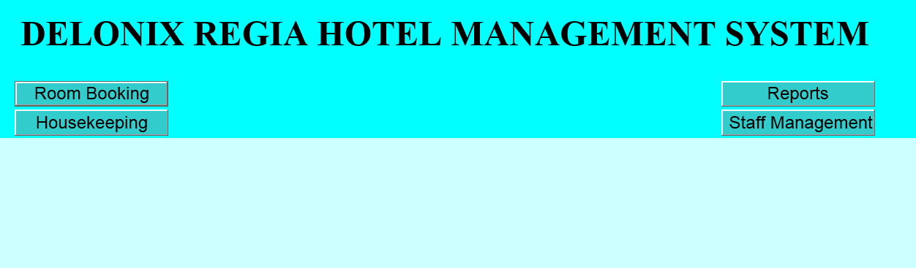
User Interface Requirements – ZHI yong
Room Attendants Availability
Step 1: Click on “Housekeeping”

Slide 70
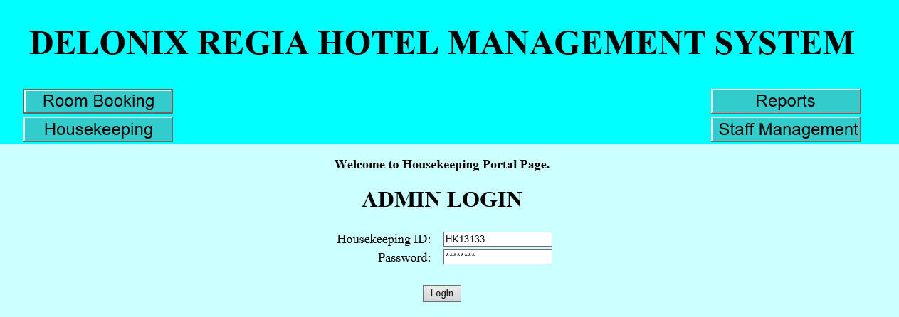
User Interface Requirements – ZHI yong
Room Attendants Availability
Step 2: Enter the administrator user ID and password

Slide 71
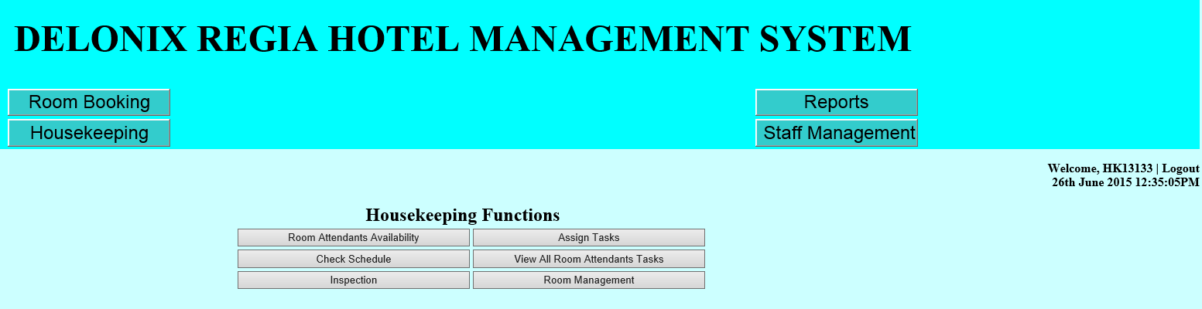
User Interface Requirements – ZHI yong
Room Attendants Availability
Step 3: Select “Room Attendants Availability”

Slide 72
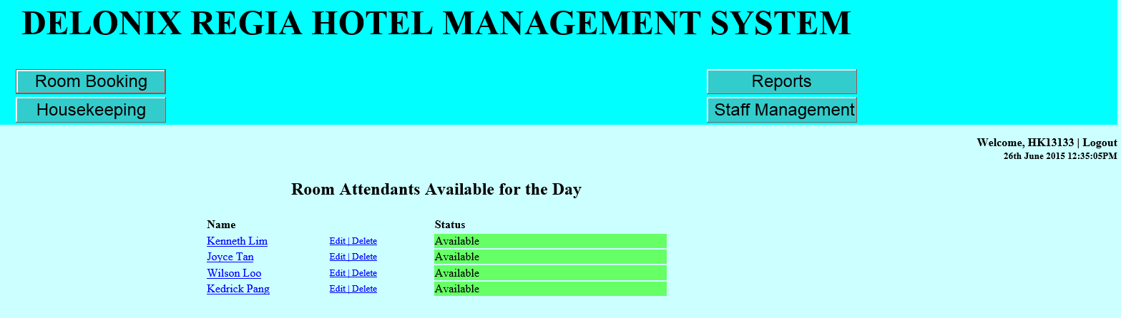
User Interface Requirements – ZHI yong
Room Attendants Availability
Step 4: Information is shown out to display the number of available room attendants.

Slide 73
User Interface Requirements – ZHI yong
Tasks Allocation
Step 1: Click on “Housekeeping”

Slide 74
User Interface Requirements – ZHI yong
Tasks Allocation
Step 2: Enter the administrator user ID and password

Slide 75
User Interface Requirements – ZHI yong
Tasks Allocation
Step 3: Select “Assign Tasks”

Slide 76
User Interface Requirements – ZHI yong
Tasks Allocation
Step 4: Information is shown out for available room attendant. Click on the name to assign task to user

Slide 77
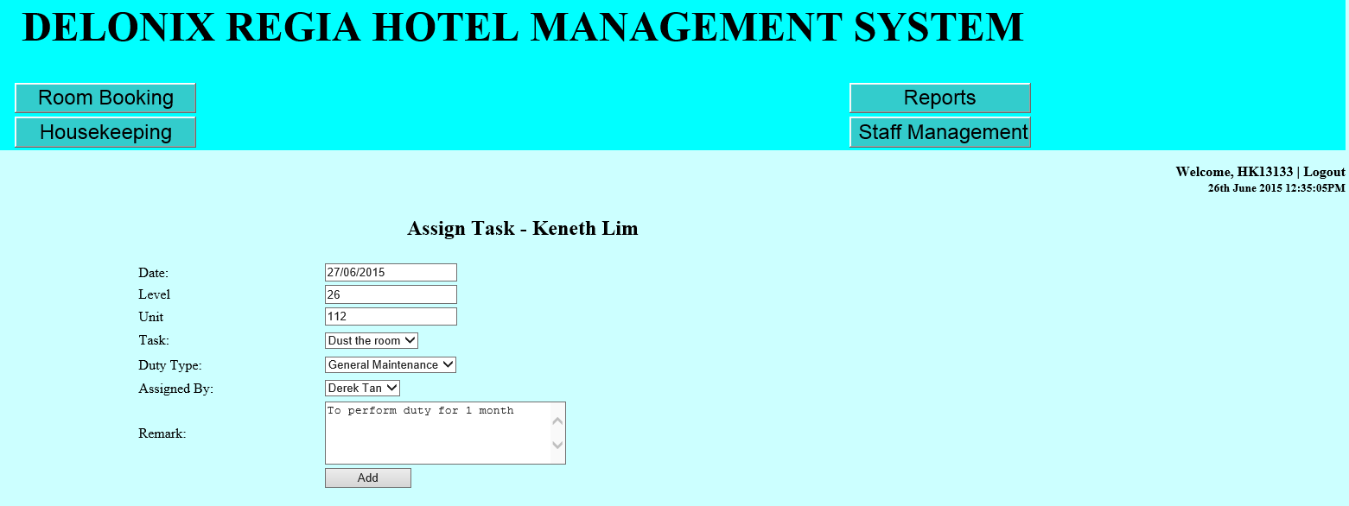
User Interface Requirements – ZHI yong
Tasks Allocation
Step 5: Fill in the tasks information as shown and click on “Add” button to save

Slide 78
User Interface Requirements – ZHI yong
Tasks Allocation (Editing)
Step 1: Click on “Housekeeping”

Slide 79
User Interface Requirements – ZHI yong
Tasks Allocation (Editing)
Step 2: Enter the administrator user ID and password

Slide 80
User Interface Requirements – ZHI yong
Tasks Allocation (Editing)
Step 3: Select “Assign Tasks”

Slide 81
User Interface Requirements – ZHI yong
Tasks Allocation (Editing)
Step 4: Information is shown out for available room attendants. Click on the “Edit” button to edit the information

Slide 82
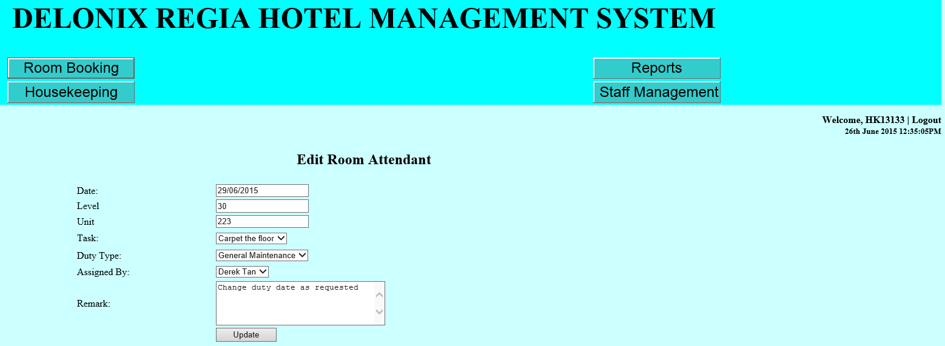
User Interface Requirements – ZHI yong
Tasks Allocation (Editing)
Step 5: Edit the information and click on the “Update” button to save

Slide 83
User Interface Requirements – ZHI yong
Tasks Allocation (Deleting)
Step 1: Click on “Housekeeping”

Slide 84
User Interface Requirements – ZHI yong
Tasks Allocation (Deleting)
Step 2: Enter the administrator user ID and password

Slide 85
User Interface Requirements – ZHI yong
Tasks Allocation (Deleting)
Step 3: Select “Assign Tasks”

Slide 86
User Interface Requirements – ZHI yong
Tasks Allocation (Deleting)
Step 4: Information is shown out for available room attendants. Click on the “Delete” button to edit the information

Slide 87
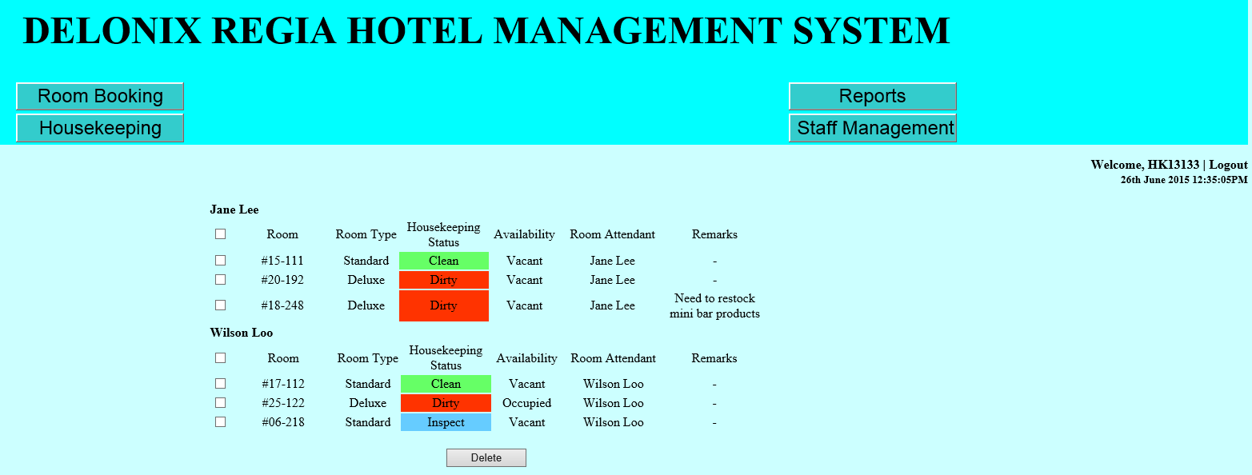
User Interface Requirements – ZHI yong
Tasks Allocation (Deleting)
Step 5: Edit the information and click on the “Update” button to save

Slide 88
User Interface Requirements – ZHI yong
View of Tasks Allocations by Room Attendants
Step 1: Click on “Housekeeping”

Slide 89
User Interface Requirements – ZHI yong
View of Tasks Allocations by Room Attendants
Step 2: Enter the administrator user ID and password

Slide 90
User Interface Requirements – ZHI yong
View of Tasks Allocations by Room Attendants
Step 3: Select “Check Schedule”

Slide 91
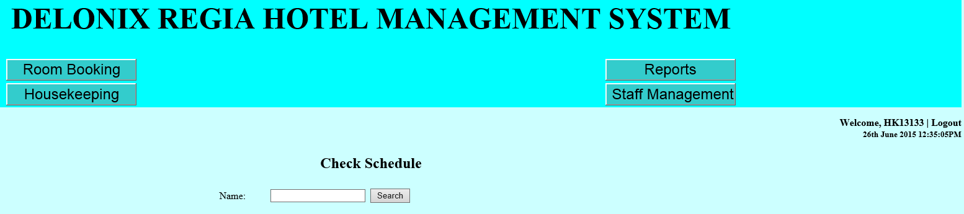
User Interface Requirements – ZHI yong
View of Tasks Allocations by Room Attendants
Step 4: Enter the room attendant name and click on the “Search” button

Slide 92
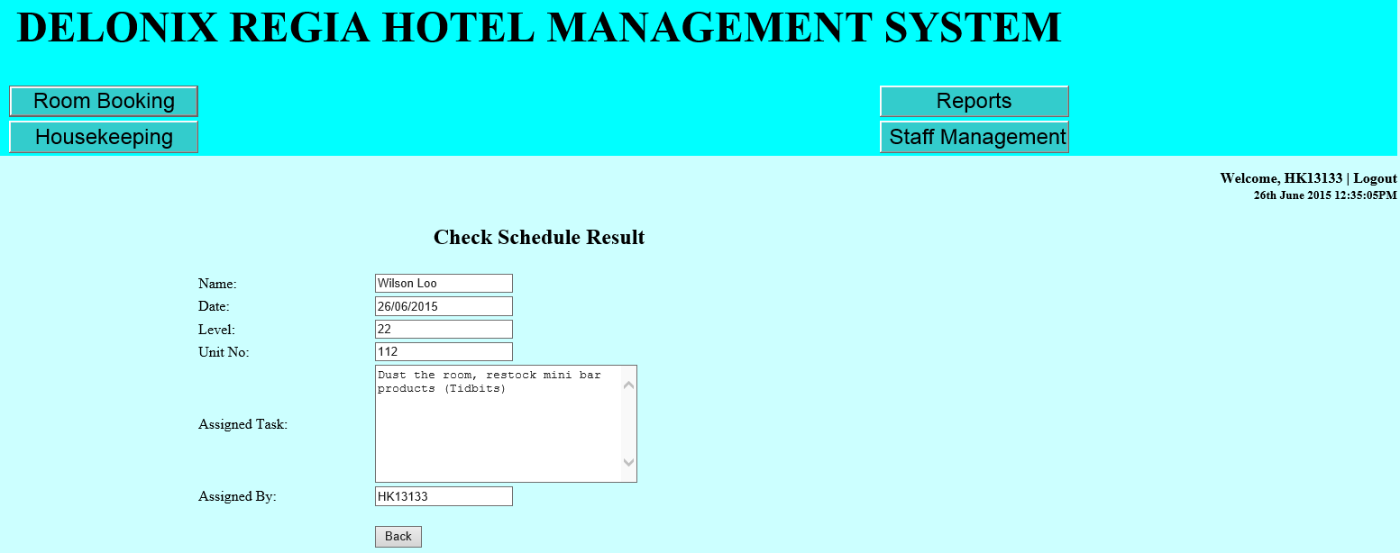
User Interface Requirements – ZHI yong
View of Tasks Allocations by Room Attendants
Step 5: Information is shown out to the room attendant

Slide 93
User Interface Requirements – ZHI yong
View all Room Attendants Task Schedule
Step 1: Click on “Housekeeping”

Slide 94
User Interface Requirements – ZHI yong
View all Room Attendants Task Schedule
Step 2: Enter the administrator user ID and password

Slide 95
User Interface Requirements – ZHI yong
View all Room Attendants Task Schedule
Step 3: Select “View All Room Attendants Tasks”

Slide 96
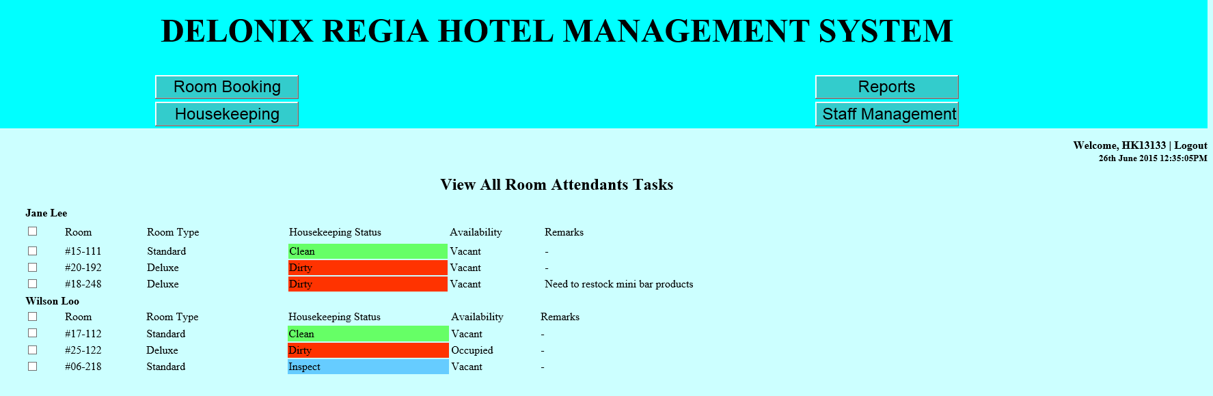
User Interface Requirements – ZHI yong
View all Room Attendants Task Schedule
Step 4: Information is display out to the user

Slide 97
User Interface Requirements – ZHI yong
Inspection
Step 1: Click on “Housekeeping”

Slide 98
User Interface Requirements – ZHI yong
Inspection
Step 2: Enter the administrator user ID and password

Slide 99
User Interface Requirements – ZHI yong
Inspection
Step 3: Select “Inspection”

Slide 100
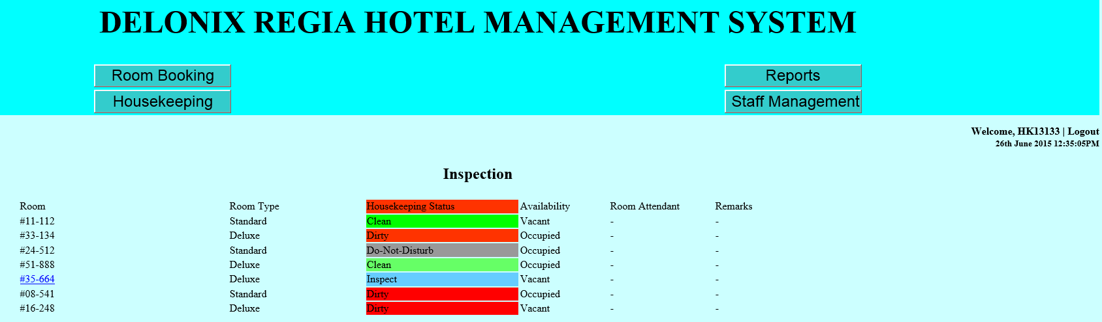
User Interface Requirements – ZHI yong
Inspection
Step 4: Room status and information is display out

Slide 101
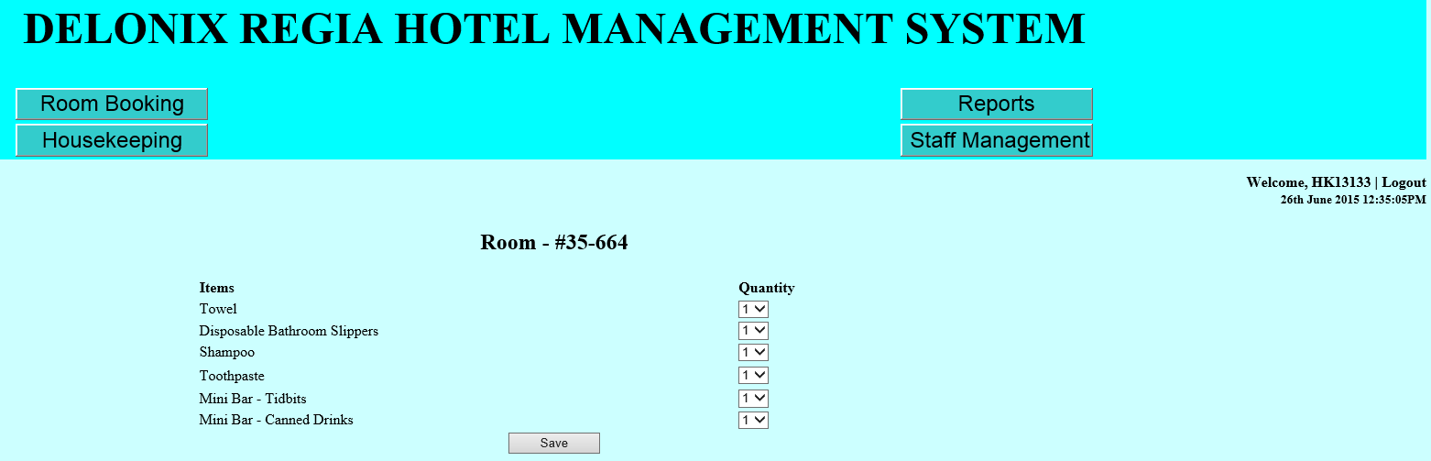
User Interface Requirements – ZHI yong
Inspection
Step 5: Clicking on the “Room” number at step 4 will brings you to modify the room products. Click on “Save” upon finishing modifying

Slide 102
User Interface Requirements – ZHI yong
Room Status
Step 1: Click on “Housekeeping”

Slide 103
User Interface Requirements – ZHI yong
Room Status
Step 2: Enter the administrator user ID and password

Slide 104
User Interface Requirements – ZHI yong
Room Status
Step 3: Select “Room Management”

Slide 105
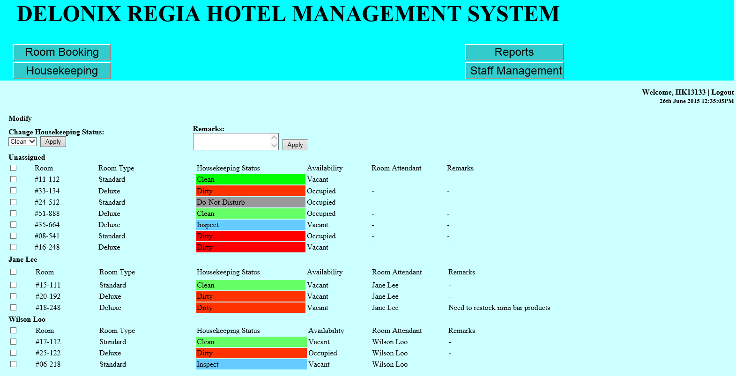
User Interface Requirements – ZHI yong
Room Status
Step 4: Information is display for all rooms and user can simply change the status of the room and add in remarks for the room as well

Slide 106
Assumptions – ZHI yong
Assumed that only authorized personnel are using the system to manage the housekeeping module.
Assumed that some of the room attendants are computer literate and thus will be able to use the housekeeping module to check their job schedule.
Assumed that for other room attendants who have no knowledge on computer but wishes to check on the task schedule. His/her other room attendant who knows how to use the system will simply check on his/her behalf.
Assumed that the software will be made user-friendly and reliable for all room attendants to understand and use.
Assumed that supervisor will be required to login to the system so that the room attendant will be allowed to use the non-administrative function. An example is, room attendants use the system to search for their schedule that is planned for them.
Assumed that room type there are a few room types available. Some examples are standard, premium, deluxe and suite.

Slide 107
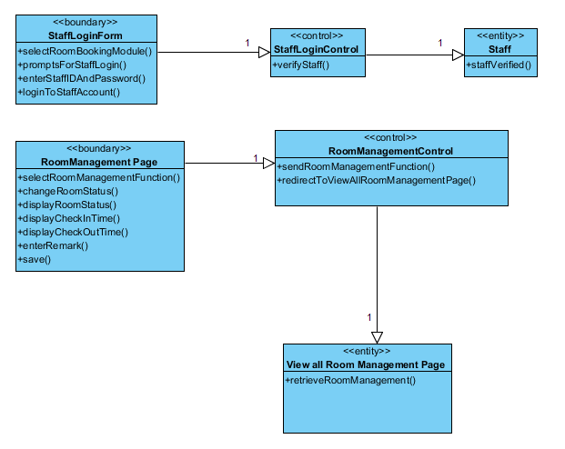
View of Participating Classes (VOPC) Diagram – ZHI yong
VOPC Diagram for Use Case: Room Management

Slide 108
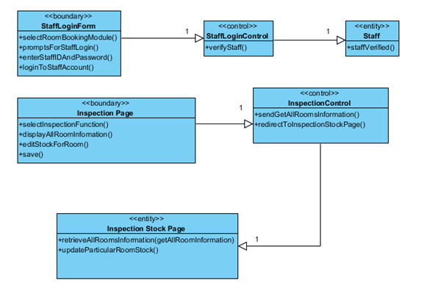
View of Participating Classes (VOPC) Diagram – ZHI yong
VOPC Diagram for Use Case: Inspection

Slide 109
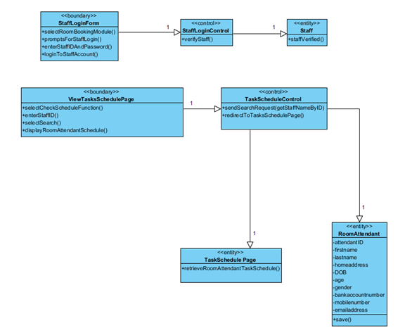
View of Participating Classes (VOPC) Diagram – ZHI yong
VOPC Diagram for Use Case: Task Schedule

Slide 110
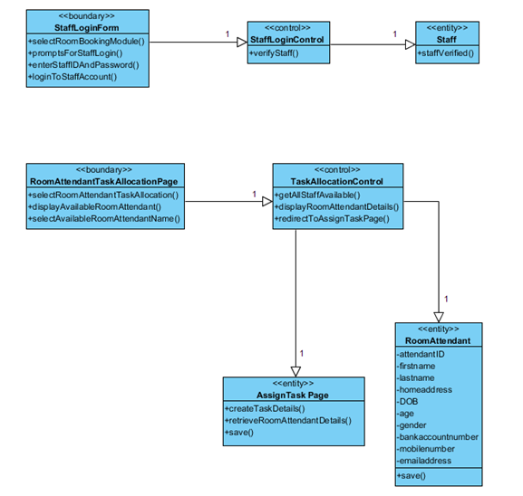
View of Participating Classes (VOPC) Diagram – ZHI yong
VOPC Diagram for Use Case: Tasks Allocation

Slide 111
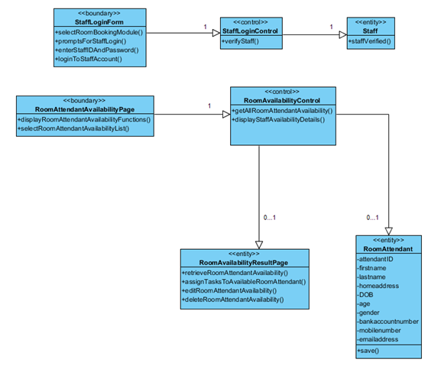
View of Participating Classes (VOPC) Diagram – ZHI yong
VOPC Diagram for Use Case: Room Attendant Availability

Slide 112
Database Schema – ZHI yong
ROOMMANAGEMENT( RMID, BookingID, RoomID, RoomLevel, RoomType, CheckInDate, CheckOutDate, NoOfGuest, Availability, Status, Remarks)
DUTY( DutyID, RMID, Date, Level, Unit, DutyName, DutyDescription, AssignedBy, Remarks)
HOUSEKEEPING( HKID, RoomID, Name, Quantity, Consume, Remarks)

Slide 113
Database Dictionary – ZHI yong
Table Name: ROOMMANAGEMENT
Table Column Name | Table Column Data Type | Table Column Null Option | Table Column Is PK | Table Column Is FK
RMID | VarChar(10) | No | Yes | No
BookingID | VarChar(10) | No | Yes | Yes
RoomID | VarChar(10) | No | Yes | Yes
RoomLevel | VarChar(10) | No | No | Yes
RoomType | VarChar(30) | No | No | Yes
CheckInDate | VarChar(20) | No | No | Yes
CheckOutDate | VarChar(20) | No | No | Yes
NoOfGuest | Int(100) | No | No | Yes
Availability | VarChar(100) | No | No | No
Status | VarChar(30) | No | No | No
Remarks | VarChar(20) | Yes | No | No

Slide 114
Database Dictionary – ZHI yong
Table Name: DUTY
Table Column Name | Table Column Data Type | Table Column Null Option | Table Column Is PK | Table Column Is FK
DutyID | VarChar(10) | No | Yes | No
RMID | VarChar(10) | No | Yes | Yes
Date | Date | No | No | No
Level | VarChar(30) | No | No | No
Unit | VarChar(30) | No | No | No
DutyName | VarChar(30) | No | No | No
DutyDescription | VarChar(50) | No | No | No
AssignedBy | VarChar(30) | No | No | No

Slide 115
Database Dictionary – ZHI yong
Table Name: HOUSEKEEPING
Table Column Name | Table Column Data Type | Table Column Null Option | Table Column Is PK | Table Column Is FK
HKID | VarChar(10) | No | Yes | No
RoomID | VarChar(10) | No | Yes | Yes
Name | VarChar(50) | No | No | No
Quantity | Int(100) | No | No | No
Consume | VarChar(100) | No | No | No
Remarks | VarChar(100) | Yes | No | No

Slide 116
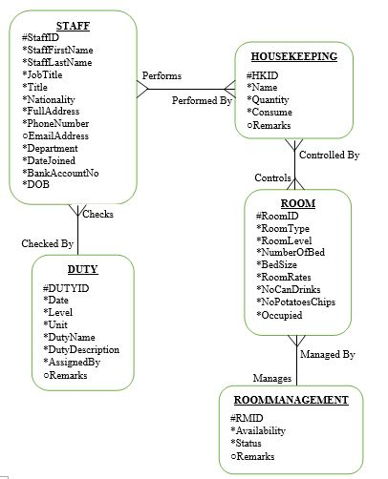
Entity Relationship Diagram (ERD) – ZHI yong

Slide 117
System Functions – HIDAYAH
Staff Management
Payroll
Staff Attendance
Leave Application
Staff Scheduling
Performance Appraisal

Slide 118
USER CHARACTERISTICS – HIDAYAH
Manager
Authority to take all the reports available in the system
Needed to approve the leave applications
Assign timetables for their staffs.
Human Resource Manager
Authority to add new staff member, modify or removing them
Manage the staff details in the database
Staffs
Access to their timetable
Apply for leave application

Slide 119
Functional Requirements – HIDAYAH
Use Case 1: Staff Management
1.1. Insert New Staff Details
1.2. Update Staff Details
1.3. Delete Staff Details
Use Case 2: Payroll
2.1. Retrieve Staff’s Payroll
Use Case 3: Staff Attendance
3.1. Retrieve Staff’s Attendance Records

Slide 120
Functional Requirements – HIDAYAH
Use Case 4: Leave Application
4.1. Insert Leave Application
4.2. View Staff’s Leave Record
Use Case 5: Staff Scheduling
5.1. Assign Shifts
5.2. View Timetable
Use Case 6: Performance Appraisal
6.1. Retrieve Staff’s Performance Appraisal

Slide 121
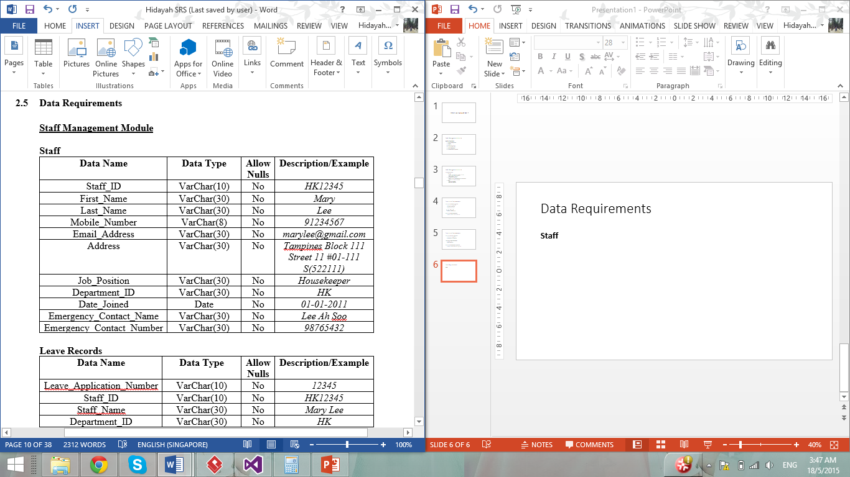
Data Requirements – HIDAYAH

Slide 122
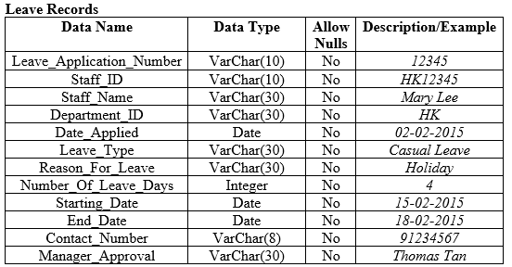
Data Requirements – HIDAYAH

Slide 123
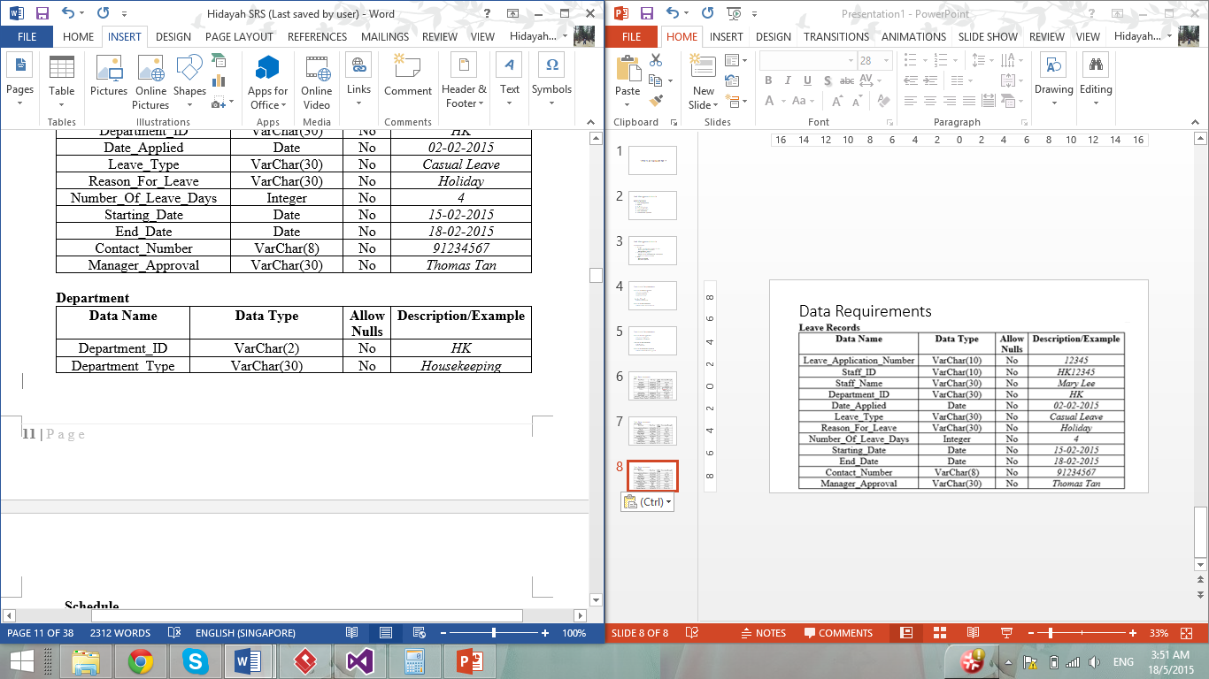
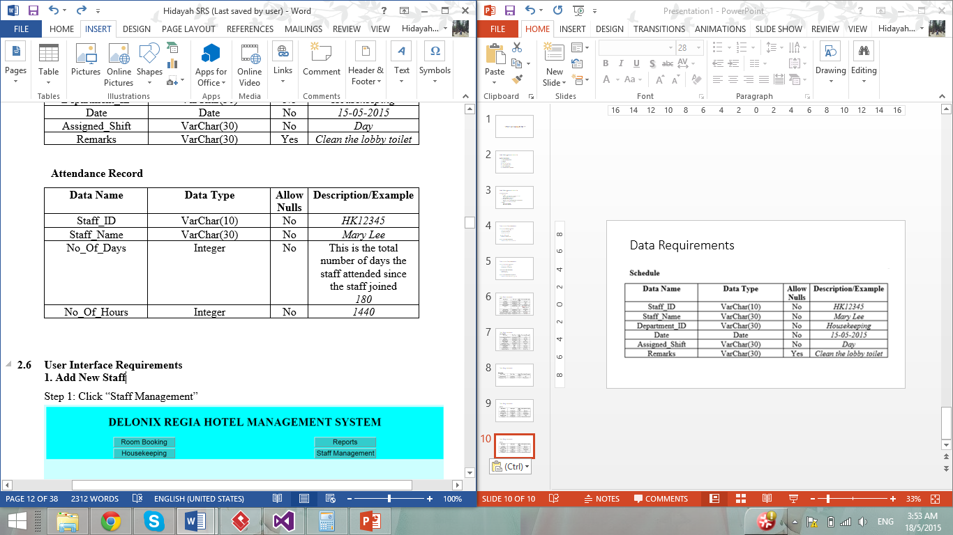
Data Requirements – HIDAYAH

Slide 124
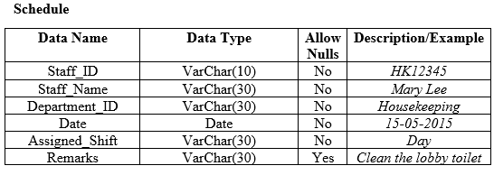
Data Requirements – HIDAYAH

Slide 125
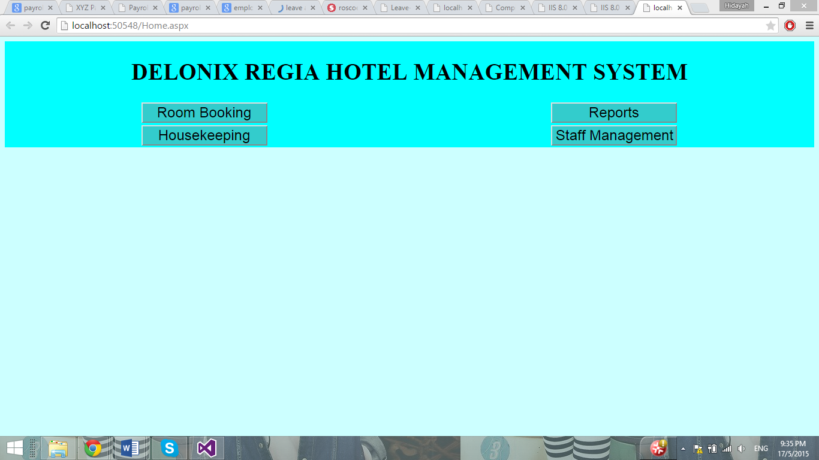
User Interface – HIDAYAH
Home Interface

Slide 126

User Interface – HIDAYAH
Login Interface

Slide 127

User Interface – HIDAYAH
Staff Management Module Interface

Slide 128

User Interface – HIDAYAH
1.1. Add New Staff

Slide 129

User Interface – HIDAYAH
1.1. Add New Staff

Slide 130

User Interface – HIDAYAH
1.2. Update/ Delete

Slide 131

User Interface – HIDAYAH
2.1. Retrieve Payroll

Slide 132

User Interface – HIDAYAH
2.1. Retrieve Payroll

Slide 133

User Interface – HIDAYAH
3.1. Retrieve Attendance Records

Slide 134

User Interface – HIDAYAH
3.1. Retrieve Attendance Records

Slide 135

User Interface – HIDAYAH
4.1. Insert Leave Application

Slide 136

User Interface – HIDAYAH
4.1. Insert Leave Application

Slide 137
User Interface – HIDAYAH
4.2. View Leave Record

Slide 138

User Interface – HIDAYAH
4.2. View Leave Record

Slide 139

User Interface – HIDAYAH
5.1. Assign Shift

Slide 140

User Interface – HIDAYAH
5.1. Assign Shift

Slide 141

User Interface – HIDAYAH
5.1. Assign Shift

Slide 142

User Interface – HIDAYAH
5.1. Assign Shift

Slide 143

User Interface – HIDAYAH
5.2. View Timetable

Slide 144

User Interface – HIDAYAH
5.2. View Timetable

Slide 145

User Interface – HIDAYAH
5.2. Performance Appraisal

Slide 146

User Interface – HIDAYAH
5.2. Performance Appraisal

Slide 147

VOPC – HIDAYAH
1.1. Insert New Staff Details

Slide 148

VOPC – HIDAYAH
1.2. Update Staff Details

Slide 149

VOPC – HIDAYAH
1.3. Delete Staff Details

Slide 150

VOPC – HIDAYAH
2.1. Retrieve Payroll

Slide 151

VOPC – HIDAYAH
4.1. Insert Leave Application

Slide 152

VOPC – HIDAYAH
4.2. View Staff Leave Record

Slide 153

VOPC – HIDAYAH
5.1. Assign Shift

Slide 154

VOPC – HIDAYAH
5.2. View Timetable

Slide 155

VOPC – HIDAYAH
5.2. Retrieve Staff Performance Appraisal

Slide 156

Database Design – HIDAYAH

Slide 157

Database Design – HIDAYAH

Slide 158

Database Design – HIDAYAH

Slide 159


Database Design – HIDAYAH

Slide 160

Database Design – HIDAYAH

Slide 161

ERD – HIDAYAH

Slide 162
Report Module Function – AARON
Room Status Report
Guest in Room Report
All Guest in Hotel Report
Room Occupancy Report
Housekeeping Report
Arrival List Report
Departure List Report

Slide 163
use cases – AARON
Use Case 1: Generate Room Status Report
Flow 1.1. Hotel staff/manager generate room status report
User click on “Reports” button at the Home Interface of the hotel management system.
User prompt to login to the system using their Staff ID and Password.
User click on “Room Status Report” at the Reporting Interface of the hotel management system.
User select the check-in date, check-out date, room type and room status.
User click on “Generate” at the Reporting Interface of the hotel management system.
System retrieve the status of the room such as room number, room status of all the room in the hotel base on the selection made.
User can choose to print the report.

Slide 164
use cases – AARON
Use Case 2: Generate Guest in Room Report
Flow 2.1 Hotel staff/manager generate guest in room report
User click on “Reports” button at the Home Interface of the hotel management system.
User prompt to login to the system using their Staff ID and Password.
User click on “Guess in Room Report” at the Reporting Interface of the hotel management system.
User will key in the particular room they want to know in the “Enter Room” input box given.
User will click “Generate” button.
System retrieve the report of the guest in room and room information according to the selection made.

Slide 165
use cases – AARON
Use Case 3: Generate all Guest in Hotel Report
Flow 3.1 Hotel staff/manager generate all guest in hotel report
User click on “Reports” button at the Home Interface of the hotel management system.
User prompt to login to the system using their Staff ID and Password
User click on “All Guest in Room Report” at the Reporting Interface of the hotel management system.
User will key in the particular day they want to know in the “Calendar” provided.
User will click “Generate” button.
System retrieve the information of all the guests in the hotel during the selected day.
User can choose to print the report.

Slide 166
use cases – AARON
Use Case 4: Generate Room Occupancy Report
Flow 4.1 Owner/Manager generate room occupancy report
User click on “Reports” button at the Home Interface of the hotel management system.
User prompt to login to the system using their Staff ID and Password.
User click on “Generate Room Occupancy Report” at the Reporting Interface of the hotel management.
System will prompt user to enter password as only manager and owner able to access to this report.
User will select daily, weekly, monthly and yearly from the interface at the room occupancy selection page.
Upon clicking the selection, system will retrieve the occupancy reports based on the selection made.
User can choose to print the report.

Slide 167
use cases – AARON
Use Case 5: Generate Housekeeping Report
Flow 5.1 Owner/Manager generate housekeeping report
User click on “Reports” button at the Home Interface of the hotel management system.
User prompt to login to the system using their Staff ID and Password.
User click on “Housekeeping report” at the Reporting Interface of the hotel management.
System will prompt user to enter password as only manager and owner able to access to this report.
User will select daily, weekly, monthly and yearly from the interface at the housekeeping selection page.
System will retrieve the housekeeping reports from the database that is stored by the housekeeping department.
User can choose to print the report.

Slide 168
use cases – AARON
Use Case 6: Generate Arrival List Report
Flow 6.1 Hotel staff/manager generate arrival list report
User click on “Reports” button at the Home Interface of the hotel management system.
User prompt to login to the system using their Staff ID and Password.
User click on “Arrival List report” at the Reporting Interface of the hotel management.
User select the date of the Arrival.
User will click “Generate” button.
System retrieve the list of customer information such as customer name, room number and arrival date.
User can choose to print the report.

Slide 169
use cases – AARON
Use Case 7: Generate Departure List Report
Flow 7.1 Hotel staff/manager generate departure list report
User click on “Reports” button at the Home Interface of the hotel management system.
User prompt to login to the system using their Staff ID and Password.
User click on “Departure List report” at the Reporting Interface of the hotel management.
User select the date of the Departure.
User will click “Generate” button.
System retrieve the list of customer information such as customer name, room number and departure date
User can choose to print the report.

Slide 170



Generate room status report UI – AARON
Step 1 Step 3
Step 2

Slide 171


Generate room status report UI – AARON
Step 4 Step 5

Slide 172
Generate guest in room report UI – AARON
Step 1 Step 3
Step 2

Slide 173


Generate guest in room report UI – AARON
Step 4
Step 5

Slide 174
Generate all guest in hotel report UI – AARON
Step 1 Step 3
Step 2

Slide 175


Generate all guest in hotel report UI – AARON
Step 4
Step 5

Slide 176

Generate Room occupancy report UI – AARON
Step 1 Step 3
Step 2
Step 4

Slide 177


Generate Room occupancy report UI – AARON
Step 5
Step 6

Slide 178
Generate Housekeeping report UI – AARON
Step 1 Step 3
Step 2
Step 4

Slide 179


Generate Housekeeping report UI – AARON
Step 5
Step 6

Slide 180
Generate Arrival list report UI – AARON
Step 1 Step 3
Step 2

Slide 181


Generate Arrival list report UI – AARON
Step 4
Step 5

Slide 182
Generate Departure List report UI – AARON
Step 1 Step 3
Step 2

Slide 183


Generate Departure List report UI – AARON
Step 4
Step 5

Slide 184
Access control – AARON
Room occupancy report and housekeeping report, only manager and admin which is the owner of the hotel can access to it.
Regular staff cannot access to the report.

Slide 185

VOPC Diagram – AARON
VOPC Diagram for Use Case: Generate room status report

Slide 186

VOPC Diagram – AARON
VOPC Diagram for Use Case: Generate Guest in Room Report

Slide 187

VOPC Diagram – AARON
VOPC Diagram for Use Case: Generate All Guest in Hotel Report

Slide 188

VOPC Diagram – AARON
VOPC Diagram for Use Case: Generate Room Occupancy Report

Slide 189

VOPC Diagram – AARON
VOPC Diagram for Use Case: Generate Housekeeping Report

Slide 190

VOPC Diagram – AARON
VOPC Diagram for Use Case: Generate Arrival List Report

Slide 191

VOPC Diagram – AARON
VOPC Diagram for Use Case: Generate Departure List Report

Slide 192
Database Schema – AARON
ROOMSTATUS( RoomID, RoomStatus, CheckInDate, CheckOutDate, RoomType,)
GUESTINROOM( RoomID, CheckInDate, Description, RoomType, CheckOutDate,)
ALLGUESTINHOTEL( Date, RoomID, RoomType, MGFirstName, MGLastName, 2GFirstName, 2GLastName, 3GFirstName, 3GLastName, 4GFirstName, 4GLastName, 5GFirstName, 5GLastName)
ROOMOCCUPANCY ( OccupancyReportType, RoomType, NumOfRoomOccupied)
HOUSEKEEPINGREPORT( HousekeepingReportType, DutyName, StaffFirstName, StaffLastName)
ARRIVALLIST( CheckInDate, MGFirstName, MGLastName, RoomID)
DEPARTURELIST(CheckOutDate, MGFirstName, MGLastName, RoomID)

Slide 193

Report ERD – AARON

Slide 194
THANK YOU

